Slide 1
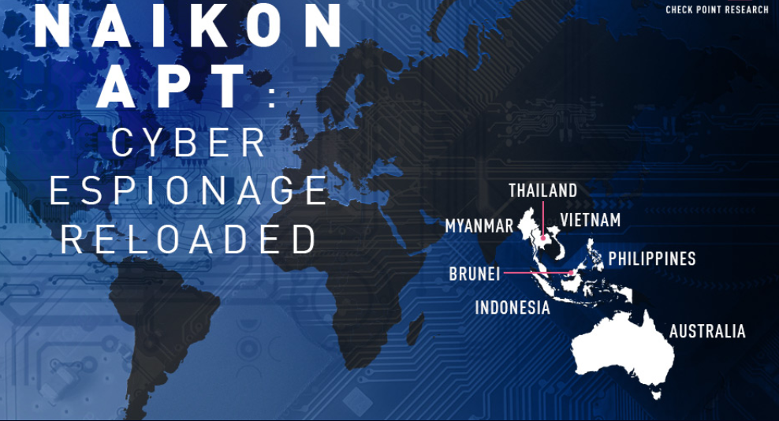
Using the data of the CheckPoint analytical report
Notes:
Each one of you will explore the given tactic and choose 1-3 technique related to the tactic and investigate it.

Slide 2

Research: Naikon (APT30)
Origin: China
Naikon active since at least 2010.
Naikon in a 2015 report described as: 'The Naikon group is mostly active in countries such as the Philippines, Malaysia, Cambodia, Indonesia, Vietnam, Myanmar, Singapore, and Nepal, hitting a variety of targets.‘
Main Weapon: Aria-body backdoor
Notes:
Each one of you will explore the given tactic and choose 1-3 technique related to the tactic and investigate it.

Slide 3
Research: Naikon (APT30)
Naikon (APT30) is assessed to be a state-sponsored cyber espionage group attributed to the Chinese People’s Liberation Army’s (PLA) Chengdu Military Region Second Technical Reconnaissance Bureau. While Naikon shares some characteristics with APT30, the two groups do not appear to be exact matches.
Active since at least 2010, Naikon has primarily conducted operations against government, military, and civil organizations in Southeast Asia, as well as against international bodies such as the United Nations Development Programme (UNDP) and the Association of Southeast Asian Nations (ASEAN).
Targets: government entities include ministries of foreign affairs, science and technology ministries, as well as government-owned companies (satellite communications operator, Telecoms, and Defense Companies).
Notes:
Each one of you will explore the given tactic and choose 1-3 technique related to the tactic and investigate it.

Slide 4
Research: Naikon (APT30)
Techniques Used
T1547 Boot or Logon Autostart Execution: Registry Run Keys / Startup Folder Naikon has modified a victim's Windows Run registry to establish persistence.
T1574 Hijack Execution Flow: DLL Side-Loading Naikon has used DLL side-loading to load malicious DLL's into legitimate executables.
T1036 Masquerading: Masquerade Task or Service Naikon renamed a malicious service taskmgr to appear to be a legitimate version of Task Manager.
T1036 Masquerading: Match Legitimate Name or Location Naikon has disguised malicious programs as Google Chrome, Adobe, and VMware executables.
T1046 Network Service Discovery: Naikon has used the LadonGo scanner to scan target networks.
T1137 Office Application Startup: Add-ins Naikon has used the RoyalRoad exploit builder to drop a second stage loader, intel.wll, into the Word Startup folder on the compromised host.
T1566 Phishing: Spearphishing Attachment Naikon has used malicious e-mail attachments to deliver malware.
Notes:
Each one of you will explore the given tactic and choose 1-3 technique related to the tactic and investigate it.

Slide 5
Research: Naikon (APT30)
Techniques Used
T1018 Remote System Discovery Naikon has used a netbios scanner for remote machine identification.
T1053 Scheduled Task/Job: Scheduled Task Naikon has used schtasks.exe for lateral movement in compromised networks.
T1518 Software Discovery: Security Software Discovery Naikon uses commands such as netsh advfirewall firewall to discover local firewall settings.
T1016 System Network Configuration Discovery Naikon uses commands such as netsh interface show to discover network interface settings.
T1204 User Execution: Malicious File Naikon has convinced victims to open malicious attachments to execute malware.
T1078 Valid Accounts: Domain Account Naikon has used administrator credentials for lateral movement in compromised networks.
T1047 Windows Management Instrumentation Naikon has used WMIC.exe for lateral movement.
Notes:
Each one of you will explore the given tactic and choose 1-3 technique related to the tactic and investigate it.

Slide 6
Research: Naikon (APT30)
IOC list
MD5 f9d71f32de83f9ecfdc77801a71da7bf
SHA- 1560423901a746055a4890c87dabe2c2a59ee917a
SHA-256 d6841b2a82904efc52c6b0b9375ddd3aa70de360c9f605341631358331a66ba0
MD5 08428c94f45fb8ff568a4a288778dfb7
SHA- 00934d22fb37b2def8276bc22ace5dc950b66227
SHA-256 7df5442e5c334eb81a2f871623fcbed859148223ef2c543d6ffb0e628d02190d
MD5 5e37131cbd756e10a9392d2280907592
SHA- c0c39b4ffe6fa7ff627654fbdd53a3bf638da4cb
SHA-256 6a8f59ad46ad22f272d5617e8d8101af820772abd5b162e3e9a9cc5dfb2f46ac

Slide 7
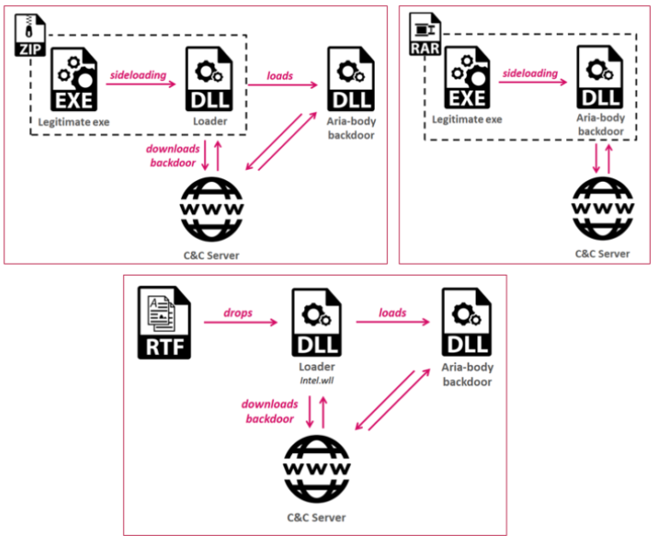
Research: Naikon (APT30)
Infection chain examples
Several different infection methods was observed during investigation:
- An RTF file utilizing the RoyalRoad weaponizer.
- Archive files that contain a legitimate executable and a malicious DLL, to be used in a DLL hijacking technique, taking advantage of legitimate executables such as Outlook and Avast proxy, to load a malicious DLL.
- Directly via an executable file, which serves as a loader.

Slide 8
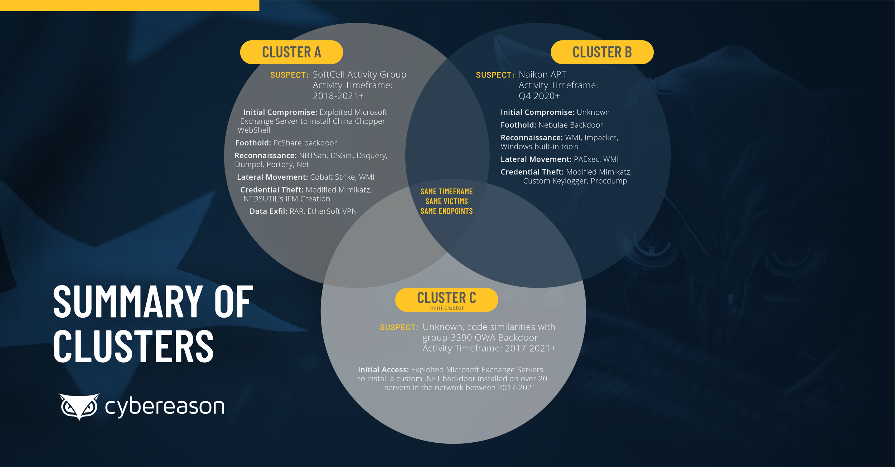
Over the past 5 years, significant overlaps with other APT groups have been found

